Slide 1
FOLDING CANE DESIGN AND ASSEMBLY
~ hot ones ~

Slide 2
1.
The Handle
Brian Ngo and Ciro Brinsko

Slide 3
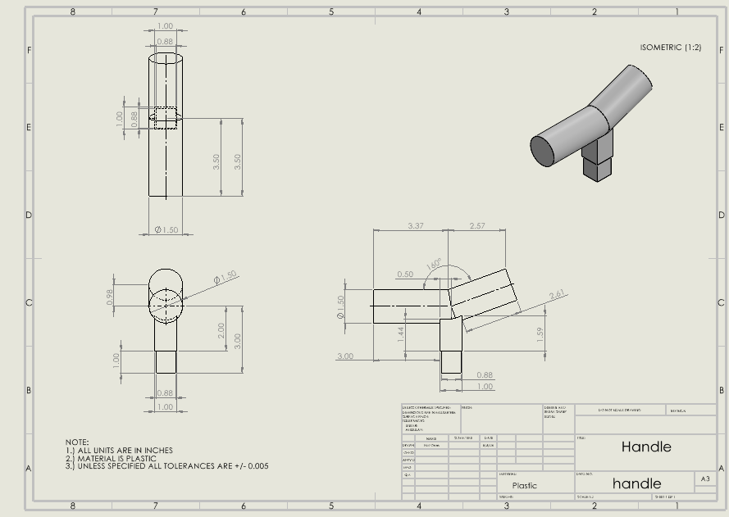
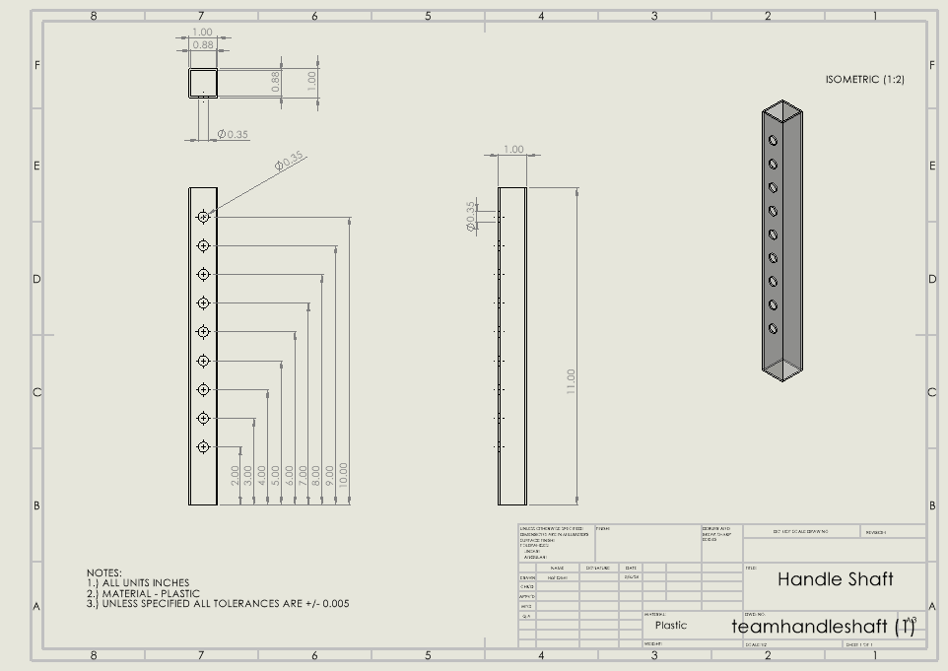
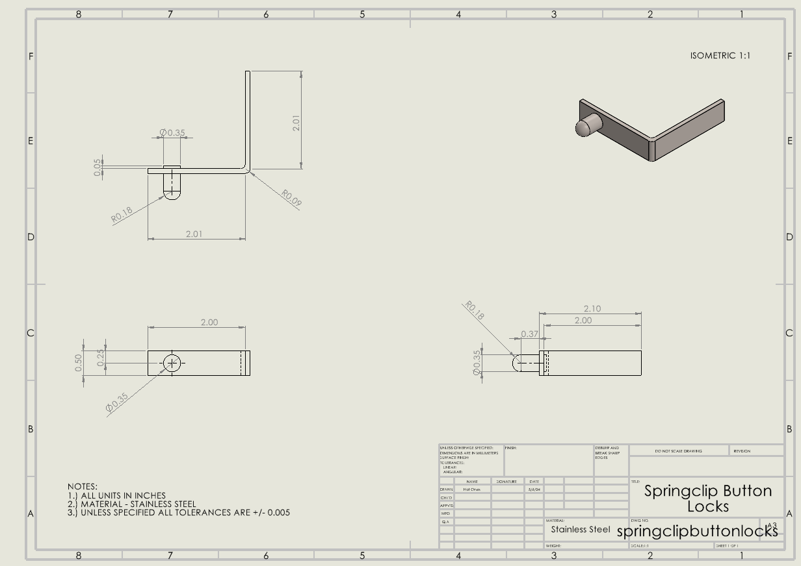
The Handle - Engineering Drawings and Designs

Slide 4
2.
The Shaft
Prince Mundy and
Omid Ghofrani

Slide 5
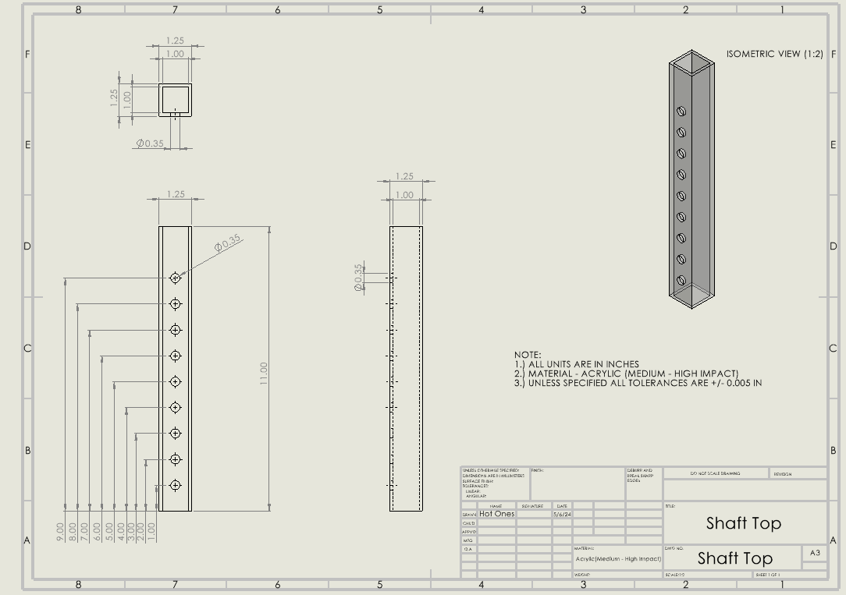
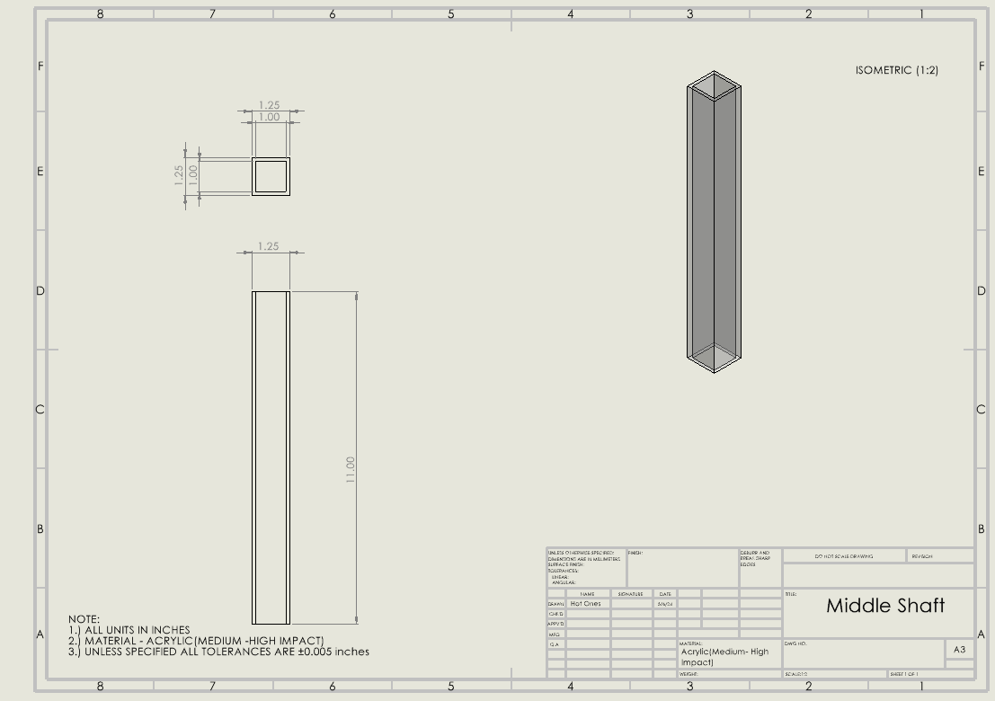
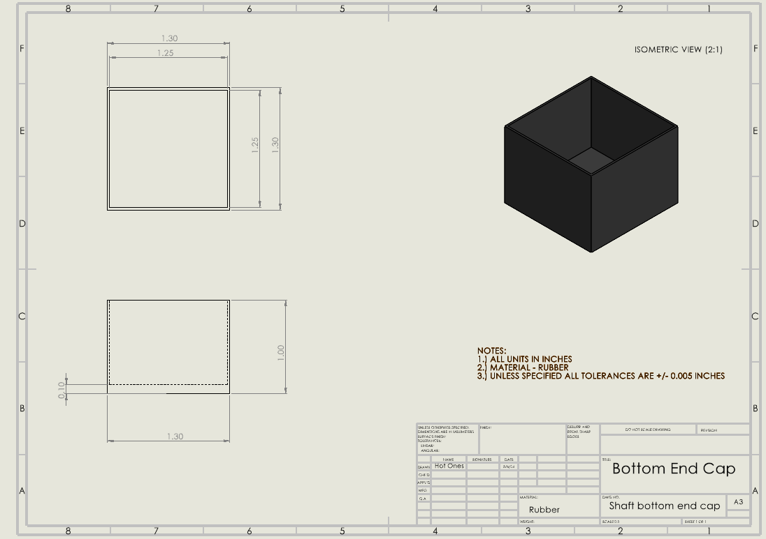
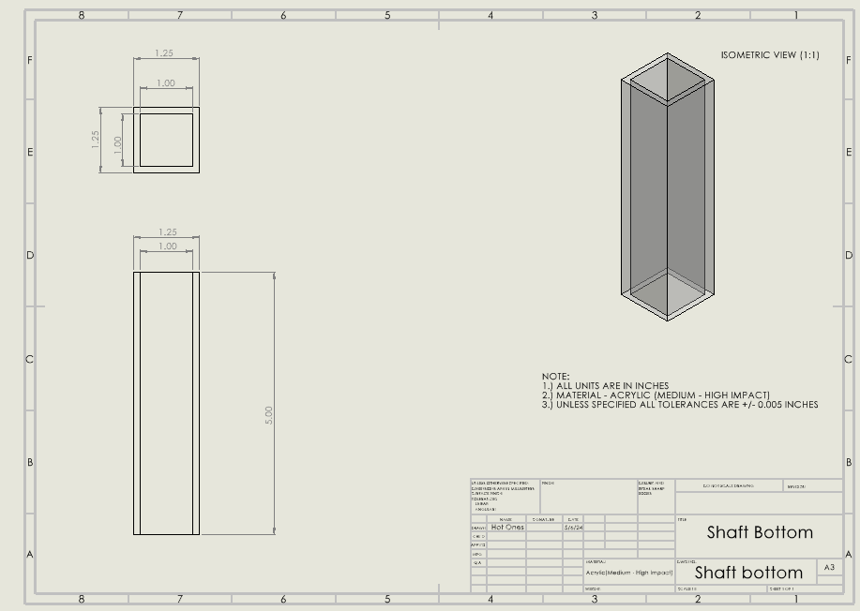
The Shaft - Engineering Drawings and Designs

Slide 6
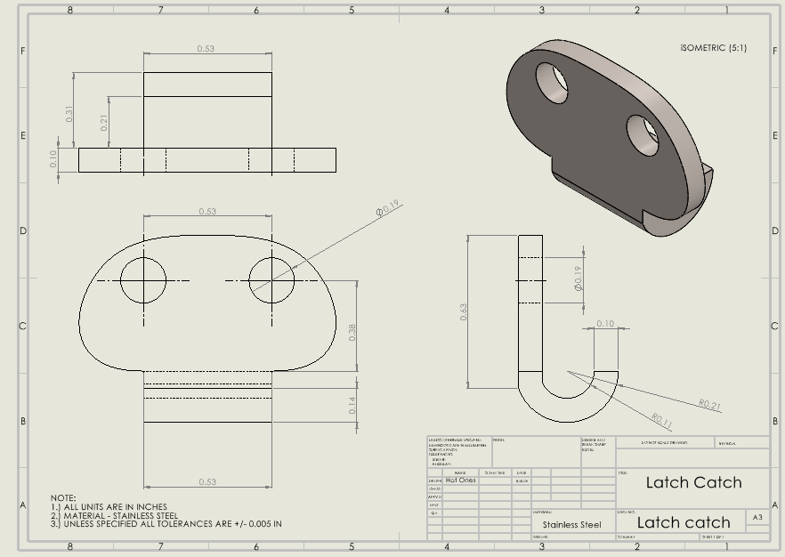
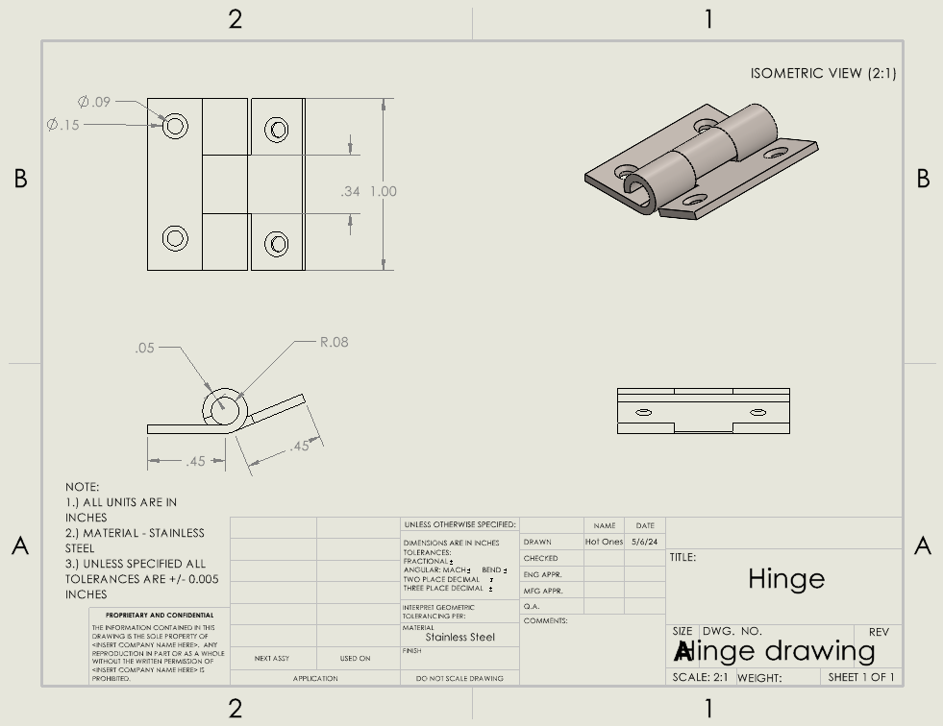
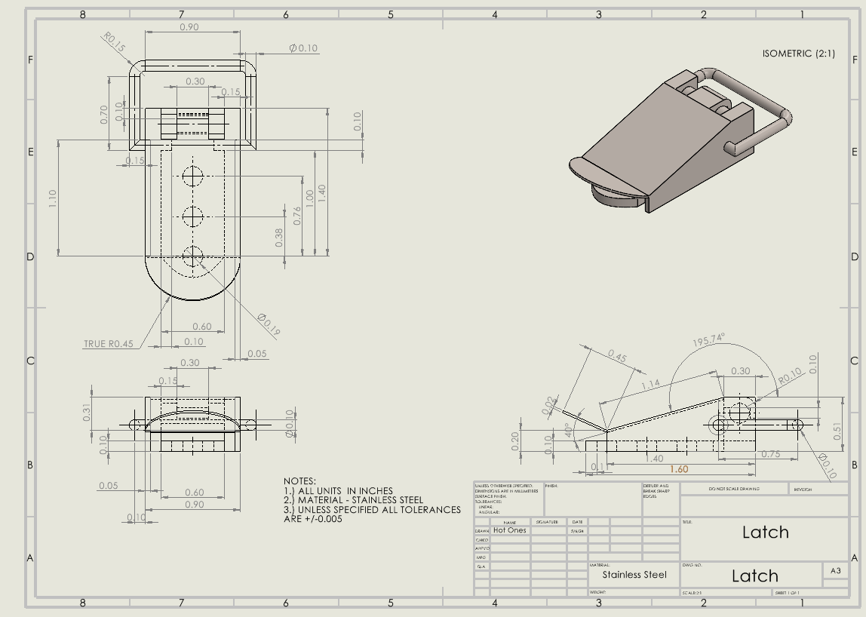
The Shaft - Engineering Drawings and Designs

Slide 7
3.
The Base
Winston James and
Satya Govindarajan

Slide 8
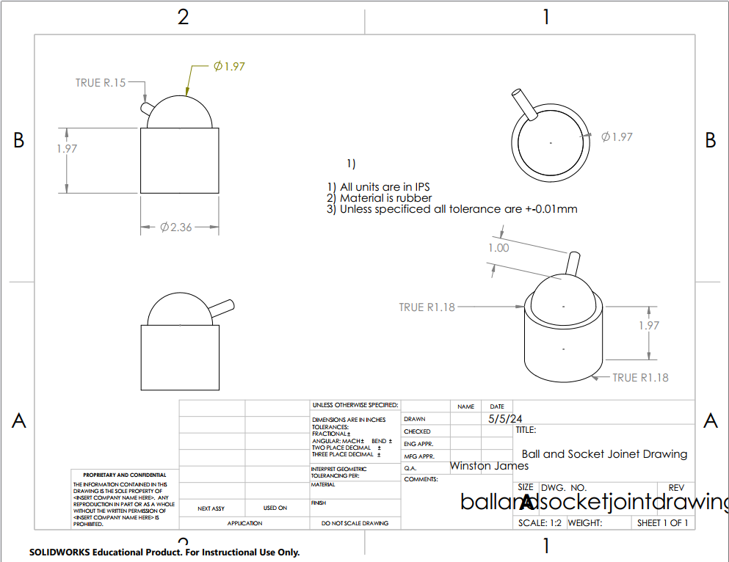
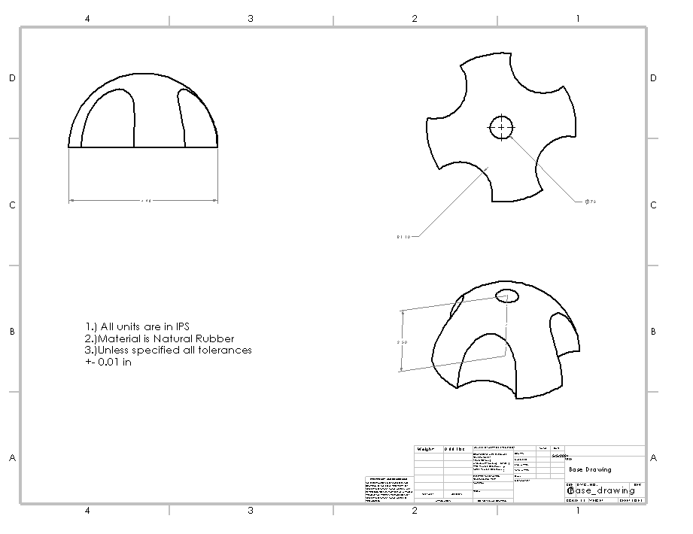
The Base - Engineering Drawings and Designs

Slide 9
4.
FREE BODY DIAGRAM

Slide 10
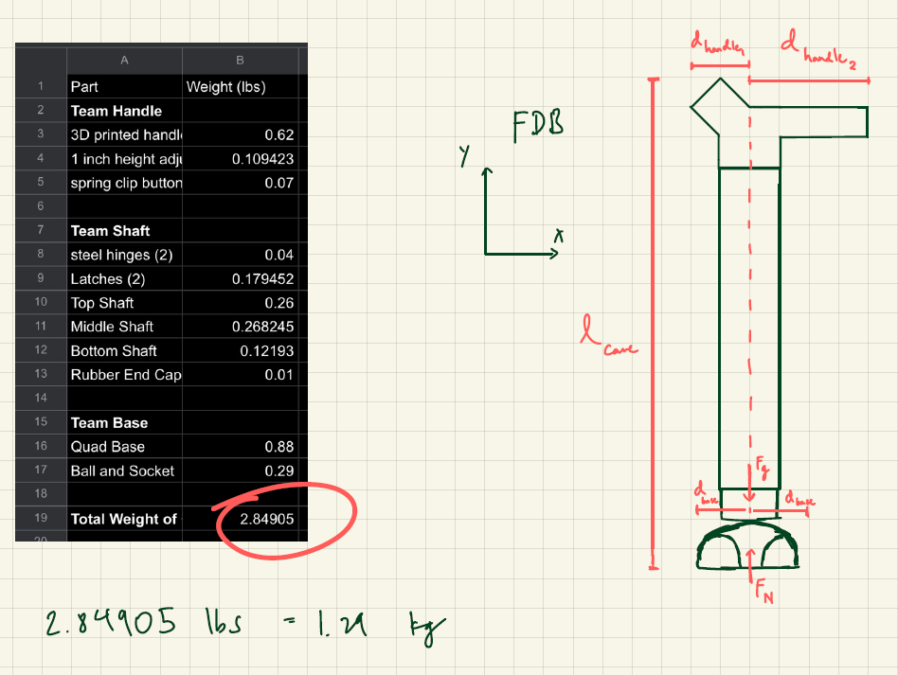
Free body Diagram

Slide 11
5.
PLANS FOR ASSEMBLY

Slide 12
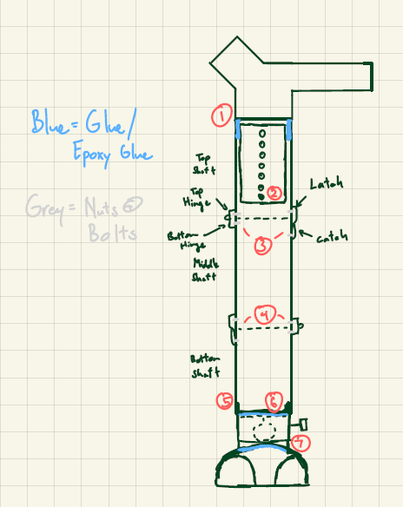
Flow Chart
3D printed handle glued to inner top shaft
Inner top shaft held in place by spring clip button lock to outer top shaft
Top hinge & latch attaches to top shaft, and bottom hinge & latch catch attach to the middle shaft via nuts and bolts
Hinge 2 & latch 2 repeated step 3 for middle & bottom shaft but on the opposite side where step 3 was placed
Rubber end cap placed at bottom of bottom shaft via force or glue
Rubber end cap attaches to the top of ball and socket joint via epoxy putty
Ball and socket joint attaches to rubber quad base via epoxy putty

